Slide 1
Section 13.2
Arithmetic Sequences
Copyright © 2012 Pearson Education, Inc. Publishing as Prentice Hall.

Slide 2
Copyright © 2012 Pearson Education, Inc. Publishing as Prentice Hall.

Slide 3
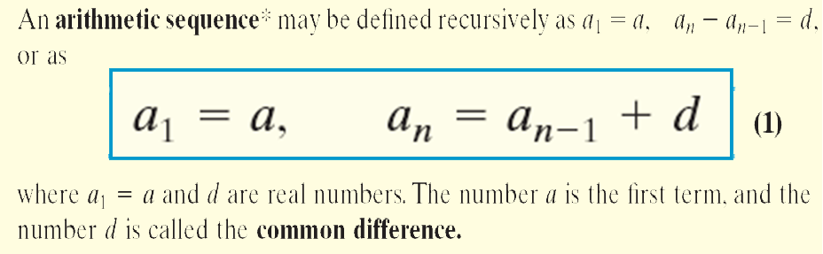
Arithmetic Sequence
Copyright © 2012 Pearson Education, Inc. Publishing as Prentice Hall.

Slide 4

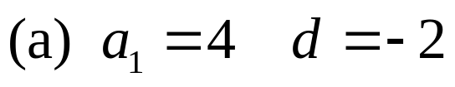
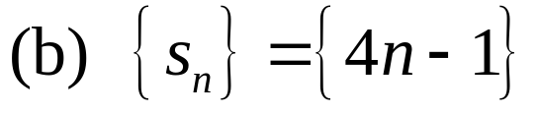
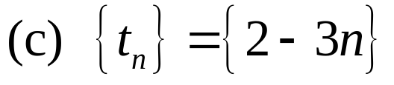
Show that the sequence is arithmetic. List the first term and the common difference.
(a) 4, 2, 0, –2, . . .
Copyright © 2012 Pearson Education, Inc. Publishing as Prentice Hall.

Slide 5
Copyright © 2012 Pearson Education, Inc. Publishing as Prentice Hall.

Slide 6
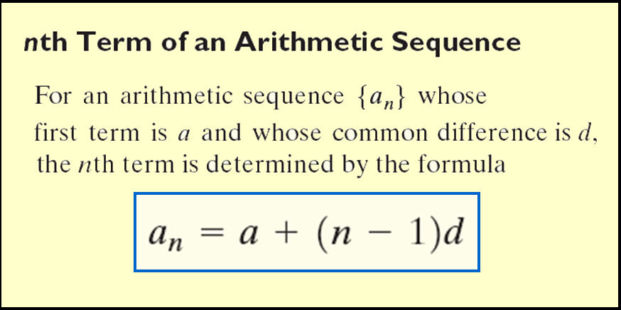
Copyright © 2012 Pearson Education, Inc. Publishing as Prentice Hall.

Slide 7
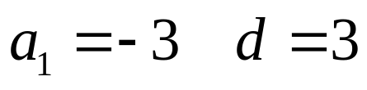
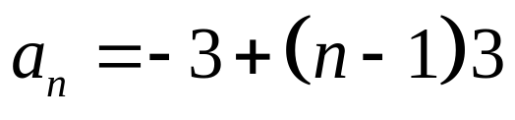
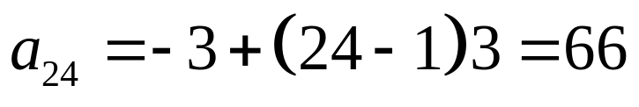
Find the twenty fourth term of the arithmetic sequence:
–3, 0, 3, 6, . . .
Copyright © 2012 Pearson Education, Inc. Publishing as Prentice Hall.

Slide 8
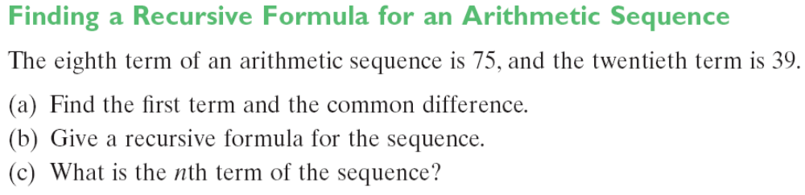



Copyright © 2012 Pearson Education, Inc. Publishing as Prentice Hall.

Slide 9
Copyright © 2012 Pearson Education, Inc. Publishing as Prentice Hall.

Slide 10
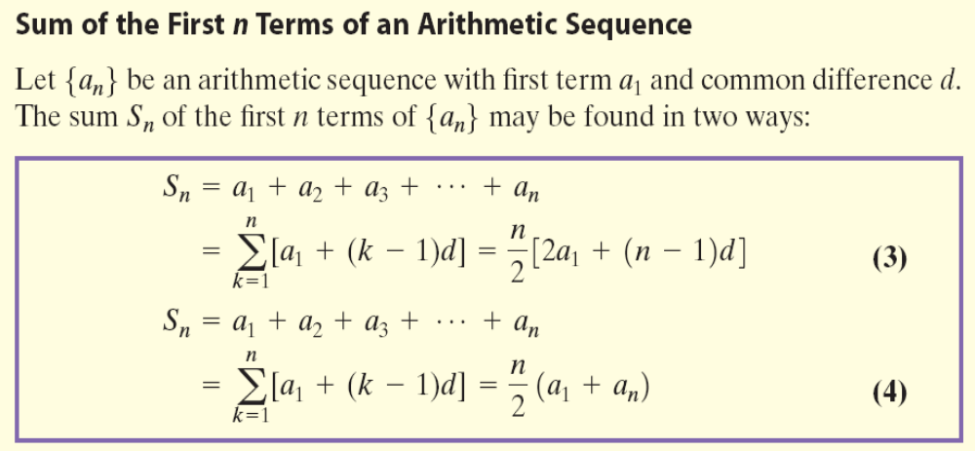
Copyright © 2012 Pearson Education, Inc. Publishing as Prentice Hall.

Slide 11
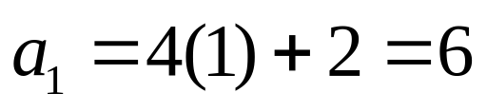
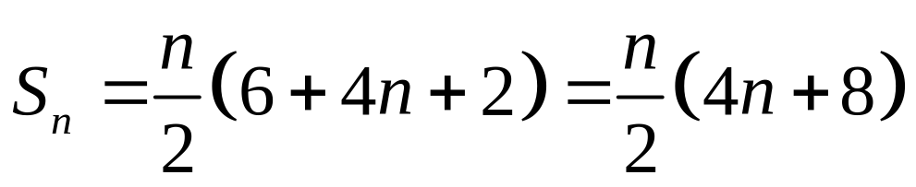
Find the sum of the first n terms of the sequence {4n + 2}
Copyright © 2012 Pearson Education, Inc. Publishing as Prentice Hall.

Slide 12
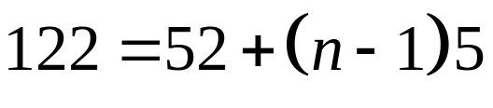
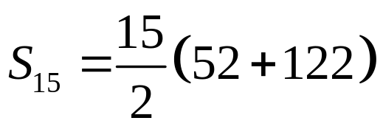
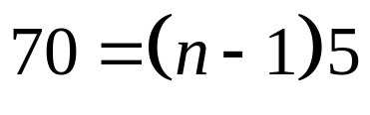



Find the sum: 52 + 57 + 62 + 67 + … + 122
Copyright © 2012 Pearson Education, Inc. Publishing as Prentice Hall.

Slide 13
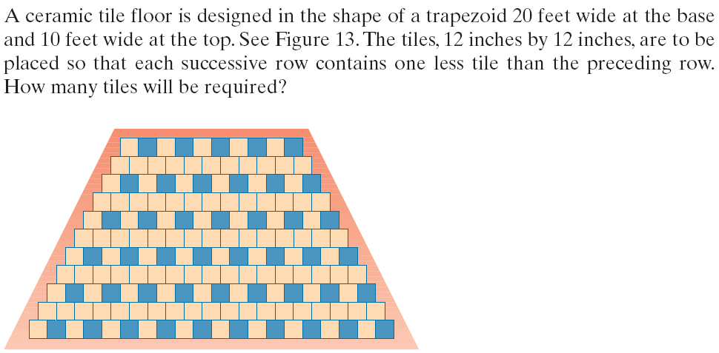
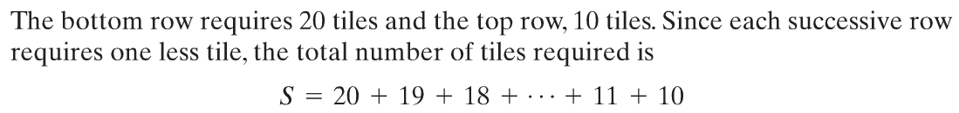
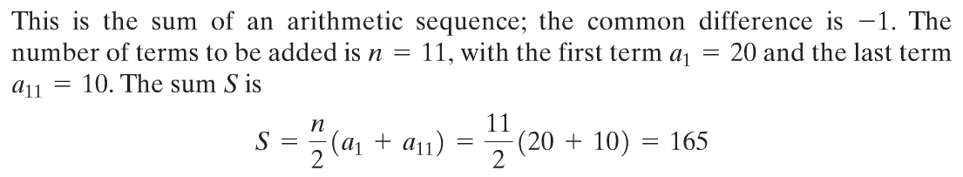
Copyright © 2012 Pearson Education, Inc. Publishing as Prentice Hall.

